Slide 1

Functional dynamics, stability and resilience in temperate grassy ecosystems
and the role of fire in restoration

Slide 2
Original condition – system greatly modified
Current system – dominated by grass and functionally unstable
Can fire play a role in restoration of grassy ecosystems?

Slide 3
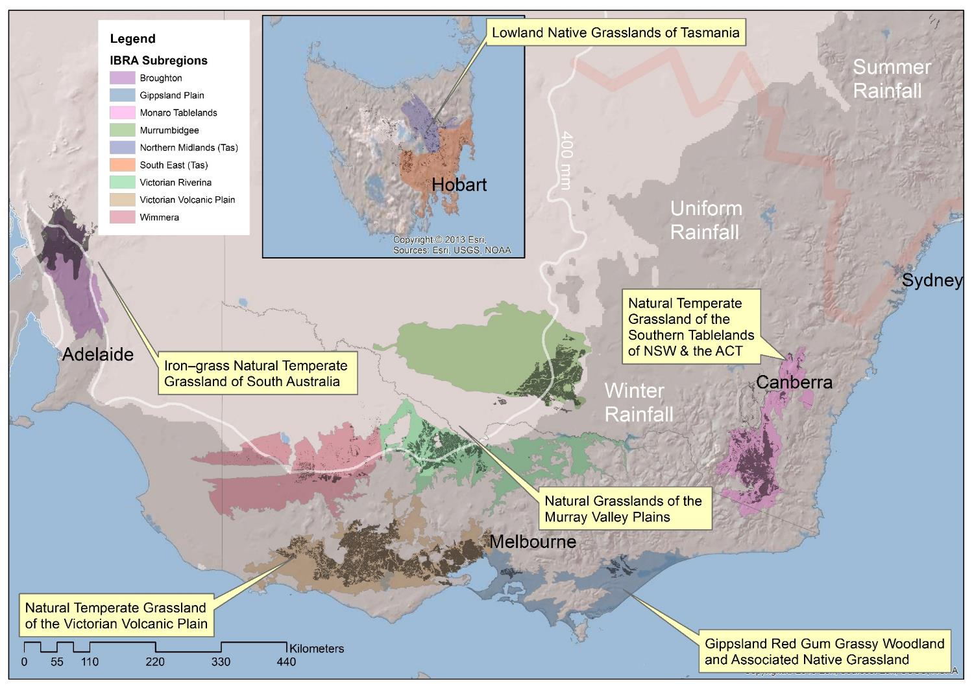

Slide 4
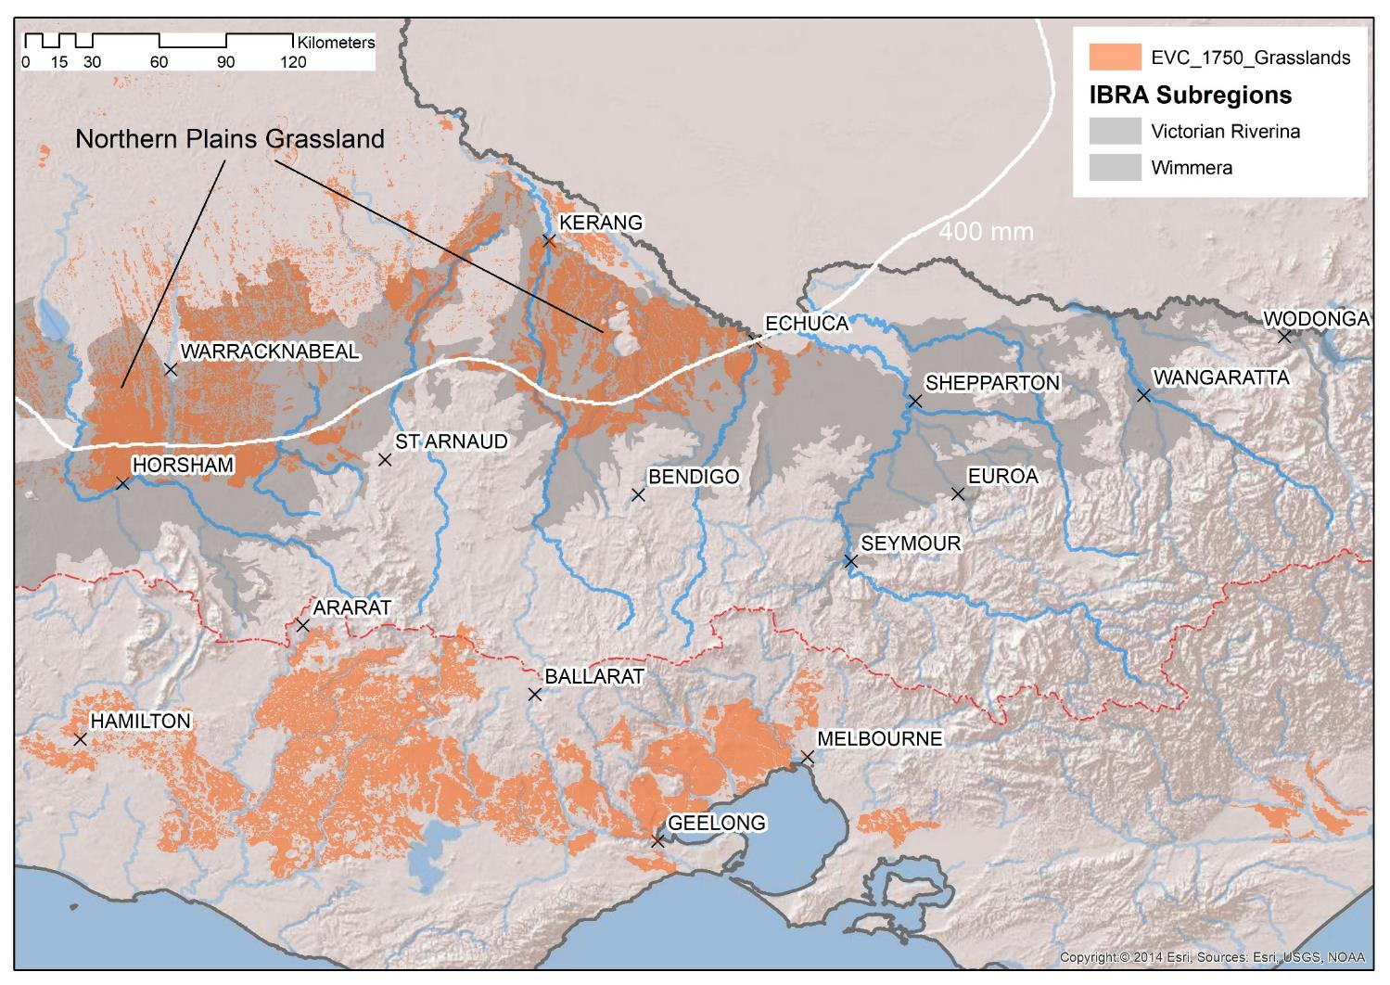

Slide 5
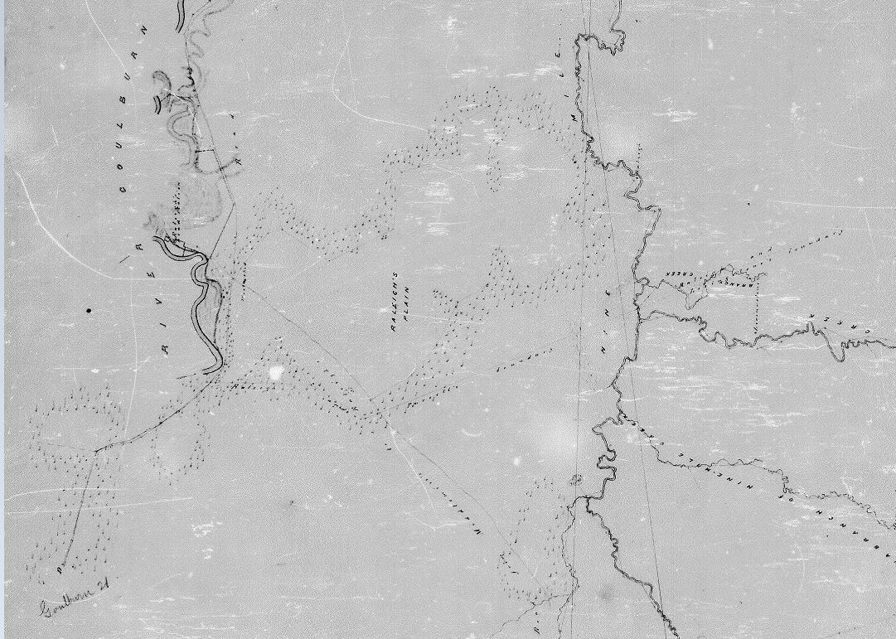
Goulburn River & Nine Mile or Pranjip Creek. GOULB 22, Arcadia -- Bunganail -- Dargalong -- Molka [microform]. 1851

Slide 6
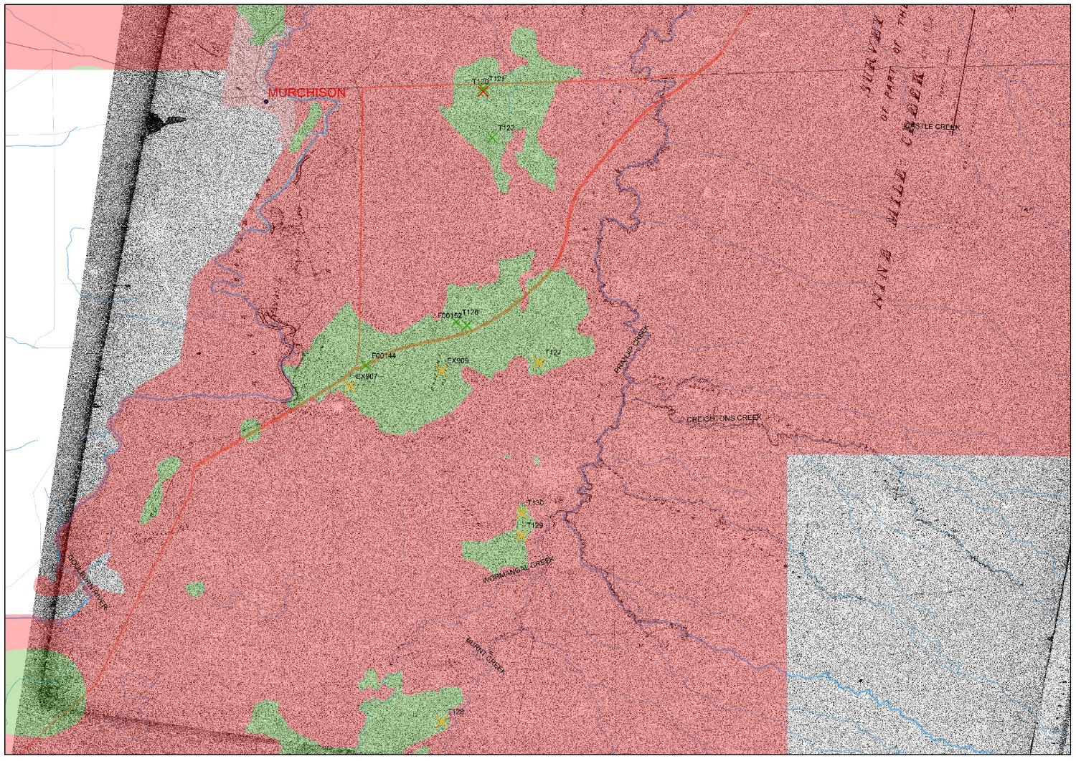

Slide 7
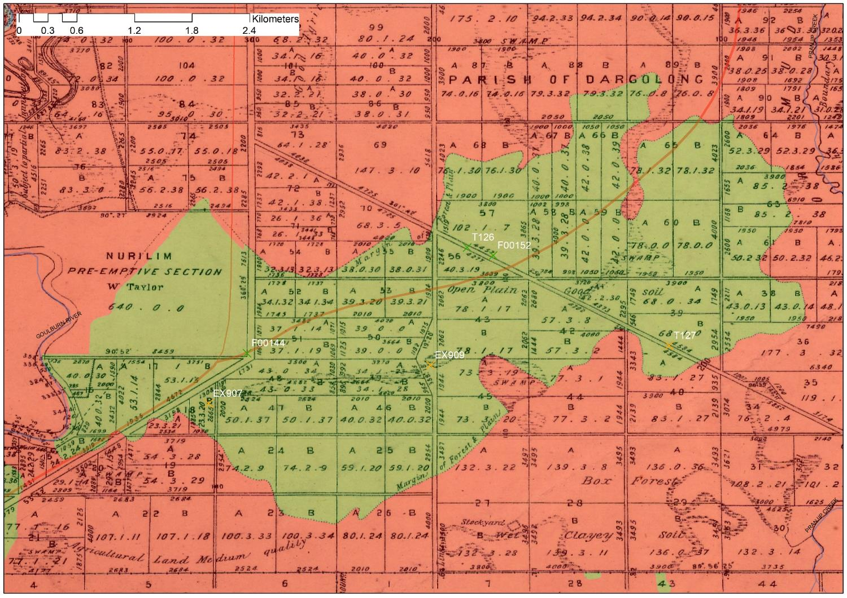
Parishes of Dargalong & Molka, Murray District [cartographic material] / surveyed by John Downey, Contract Surveyor, July 1863

Slide 8
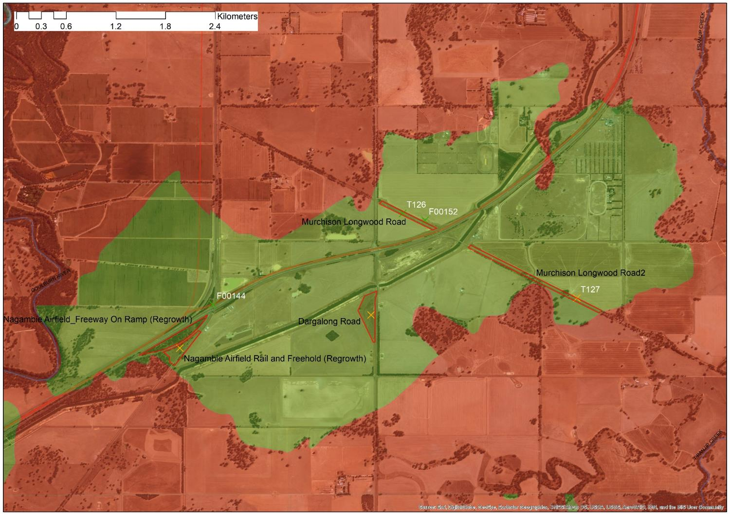

Slide 9
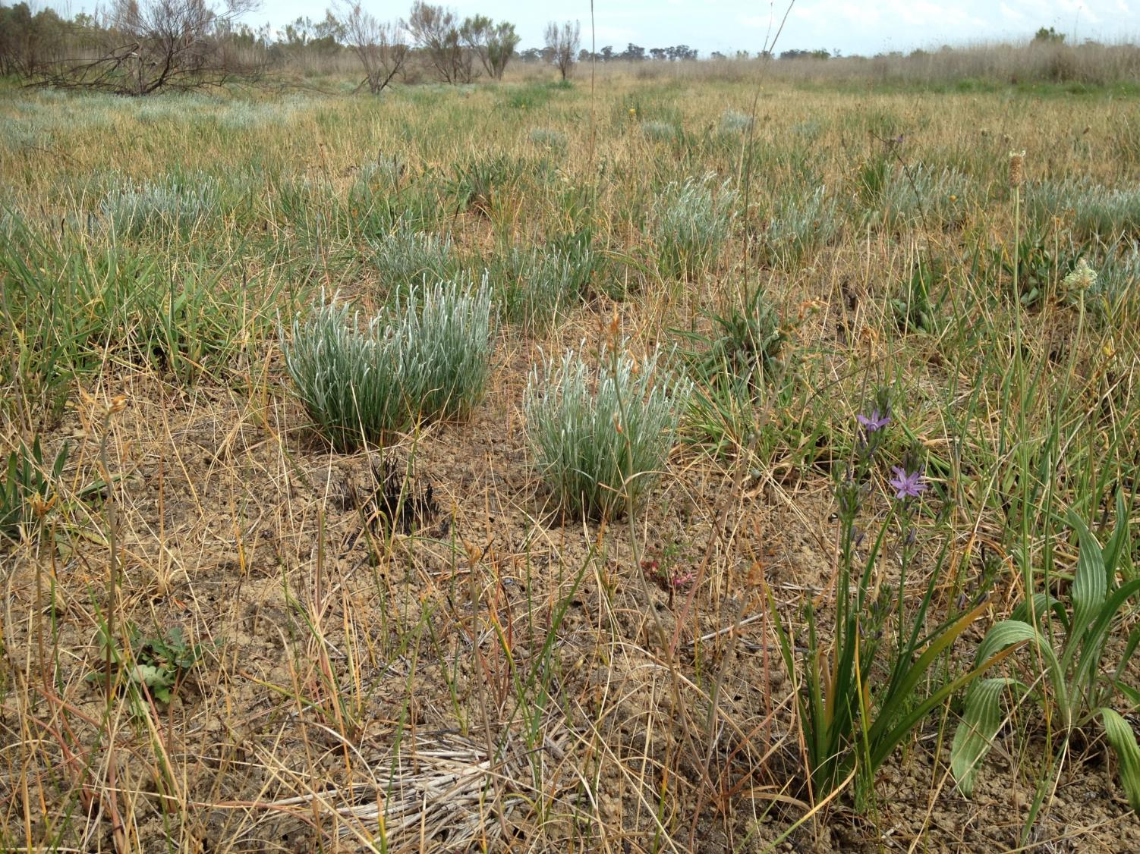

Slide 10
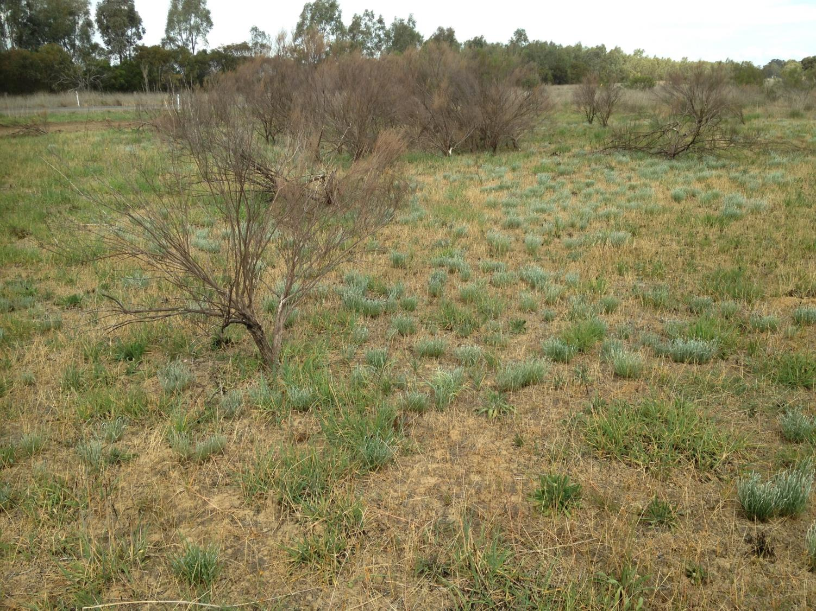

Slide 11
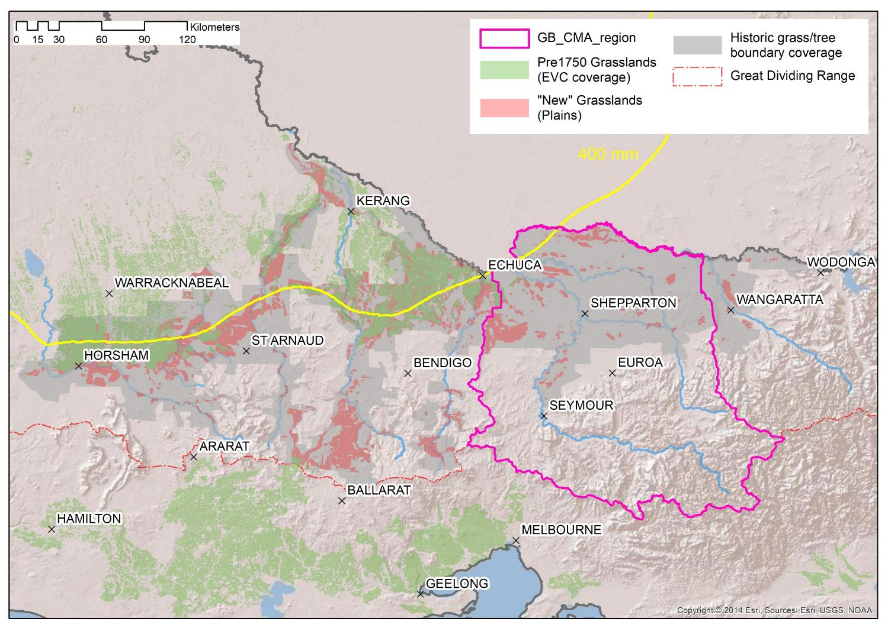

Slide 12
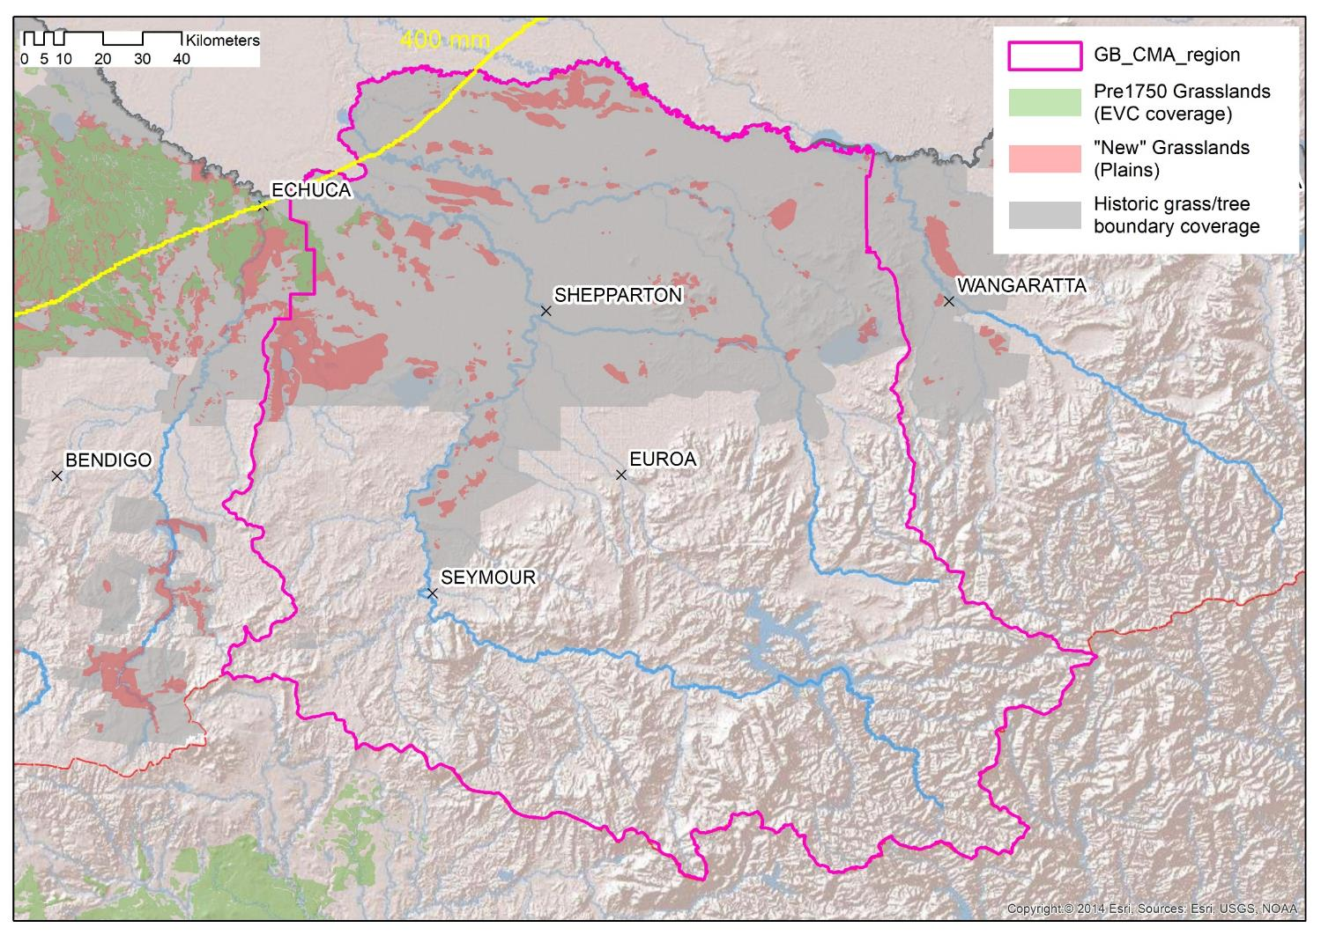

Slide 13
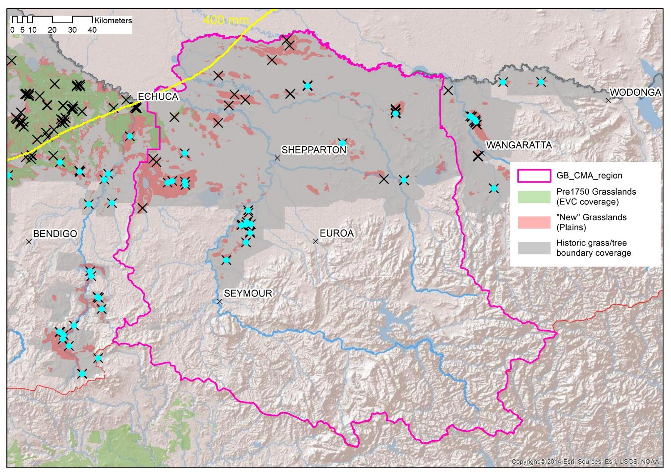
Themeda dominated grasslands of high rainfall regions – similar to VVP grasslands

Slide 14
Disturbance, Aboriginal Management and Ecological Dynamics:
Edward Curr, in July 1841, east of Rochester (Colbinabbin plains) (Curr 1965):
“the grass, though at the distance it presented the appearance of a sward, consisted of sparsely scattered tussocks of the finest descriptions; the wire grass, however, largely predominating over the kangaroo grass. As it was then winter, the interstices were filled with luxuriant herbage; the yam generally, and in some cases the myrnong or native carrot. Inferior grasses and weeds - [are] now unfortunately abundant.”
Edward Curr, 1840’s (Curr 1965):
“I have noticed not only that crops now grow where formerly they would not, and that grass is more plentiful, but that one begins to of late miss on our clayey plains the calcined and barren appearance of thirty years ago [writing in 1870’s to 1880’s], the result no doubt of the grass being feed off by stock, instead of being periodically burnt, as it used to be... Gradually the tussocks got feed down by sheep and cattle, they stooled out; and the seed got trampled into the ground around them, and in the absence of bush-fires grew, so that a sward more or less close resulted, such as we see at present. Constant feeding has cultivated this propensity, and year by year the grass is more inclined to stool.”
William Taylor 1843-46 (Bride 1969):
“The country [at least in the Longerenong district]. . . was, when [first] occupied, poor
and thinly grassed. Since it has been stocked with sheep, the grass has improved so much
that I am sure it will now fatten more than double the number it could have done at first.”

Slide 15
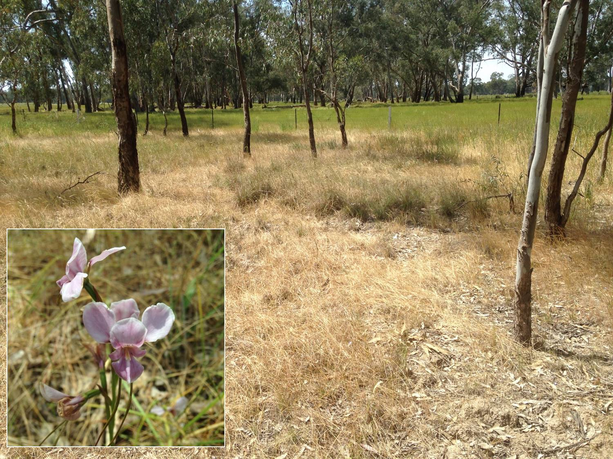

Slide 16
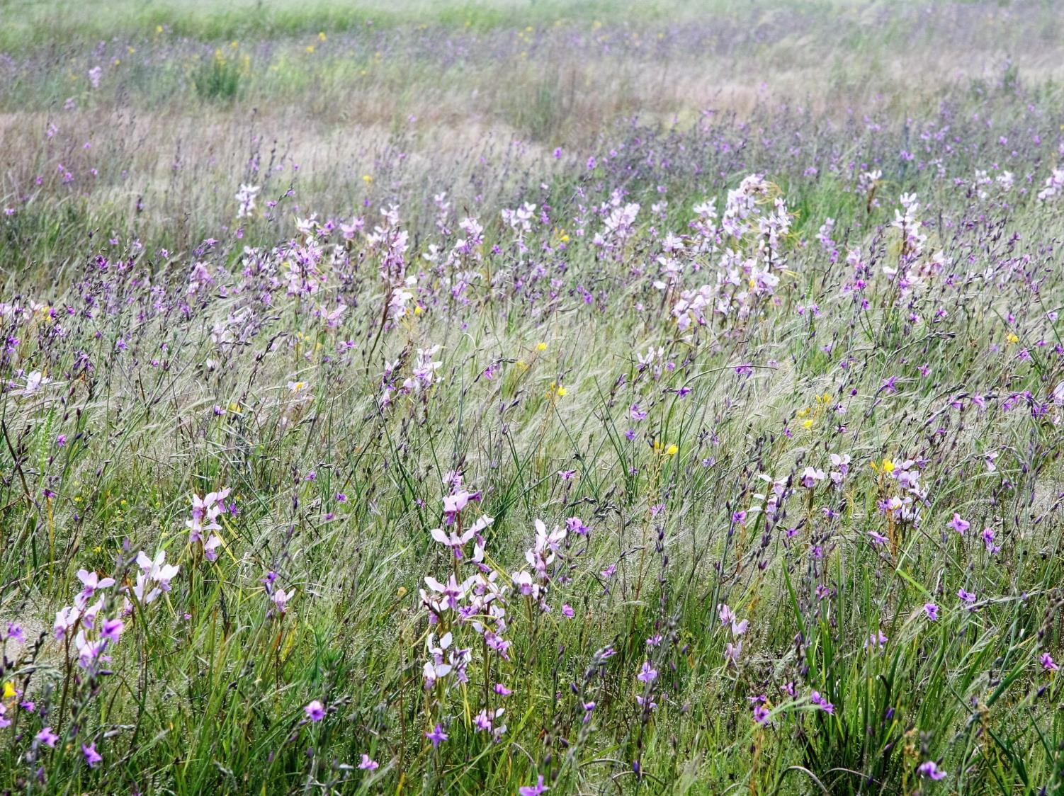
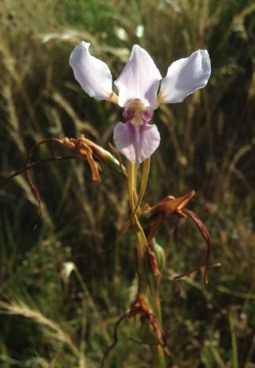

Slide 17
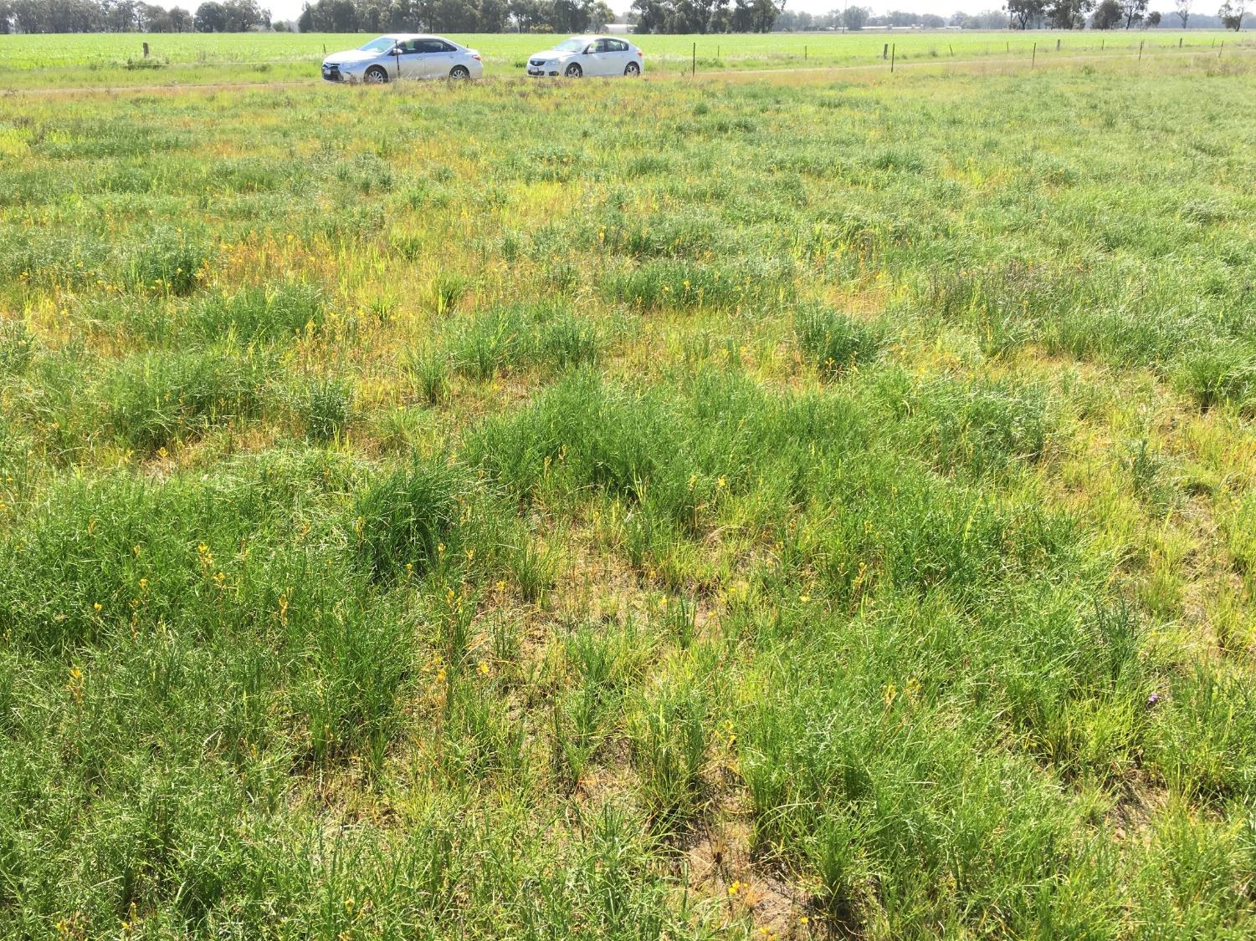
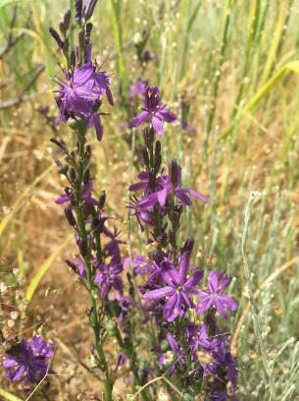
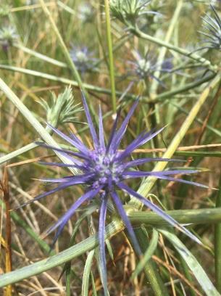
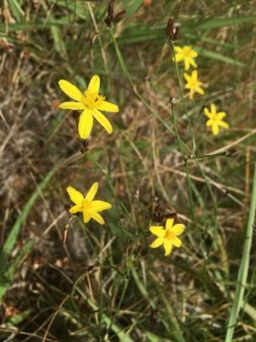
Murchison Golf Course - Spring

Slide 18
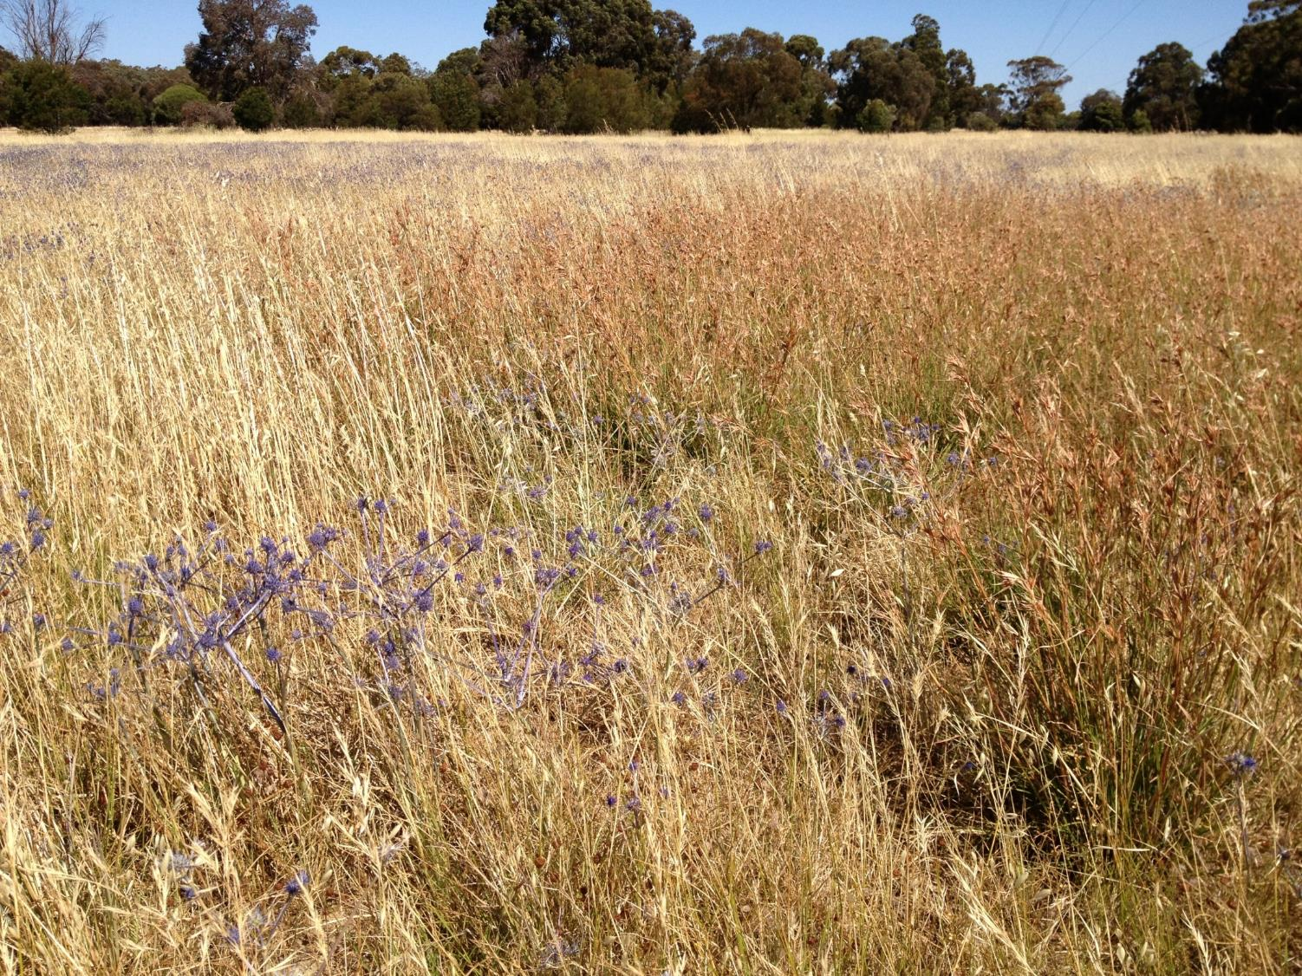
Even best remnants modified
Native grasses more abundant
Native forbs absent or less abundant
Flora and fauna extinctions
Exotic plants (esp. grasses) prolific
Grazing and cultivation replaced regular burning
Murchison Golf Course - Summer

Slide 19
Current system – dominated by grass and functionally unstable

Slide 20
Breakdown of the NPG flora into Lifeform categories

Slide 21
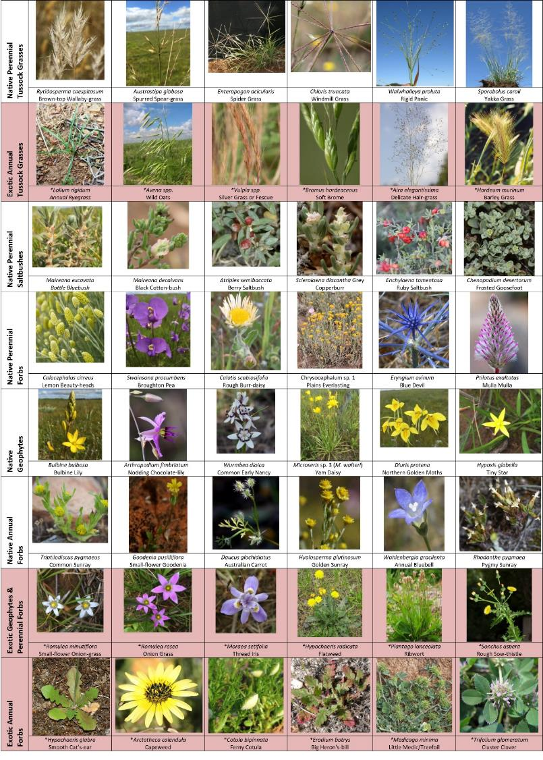

Slide 22
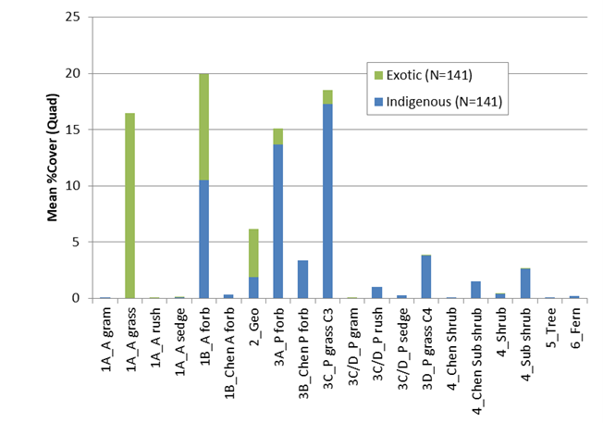
Exotic annual grasses
Annual forbs (exotic and native)
Perennial forbs (mostly native)
Perennial grasses (mostly native)
Better quality grasslands;
Widespread & more typical grasslands have < indigenous and > exotic plants

Slide 23
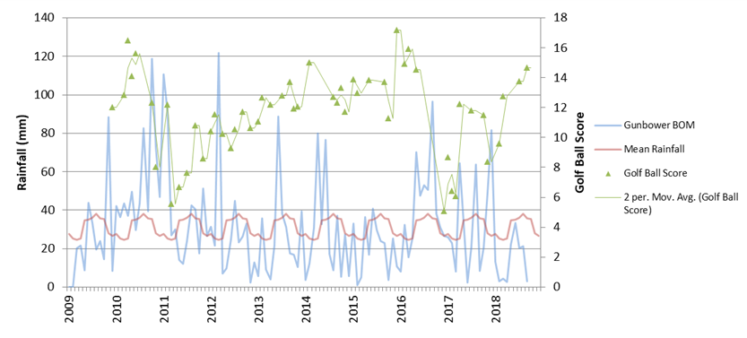
Too Dense
Too Dense
Golf Ball index (~Biomass) – Notice the significant and rapid reductions in GB scores following floods in 2010/11 (no recovery until 2016 – short lived) and later in 2016/17 (quicker recovery in Sept 2018 due to combination of quicker onset of dryer conditions and better grazing management).

Slide 24
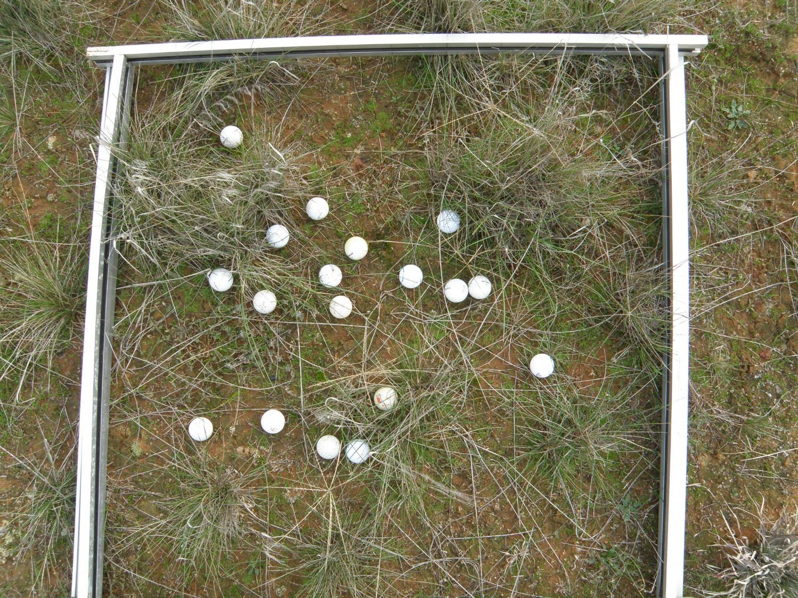

Slide 25
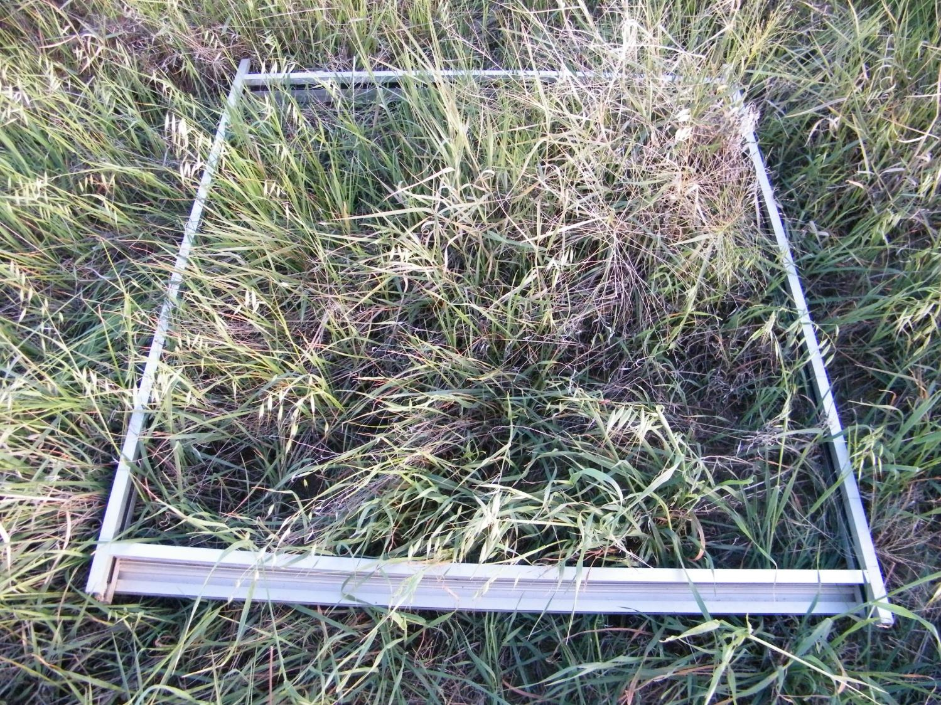

Slide 26
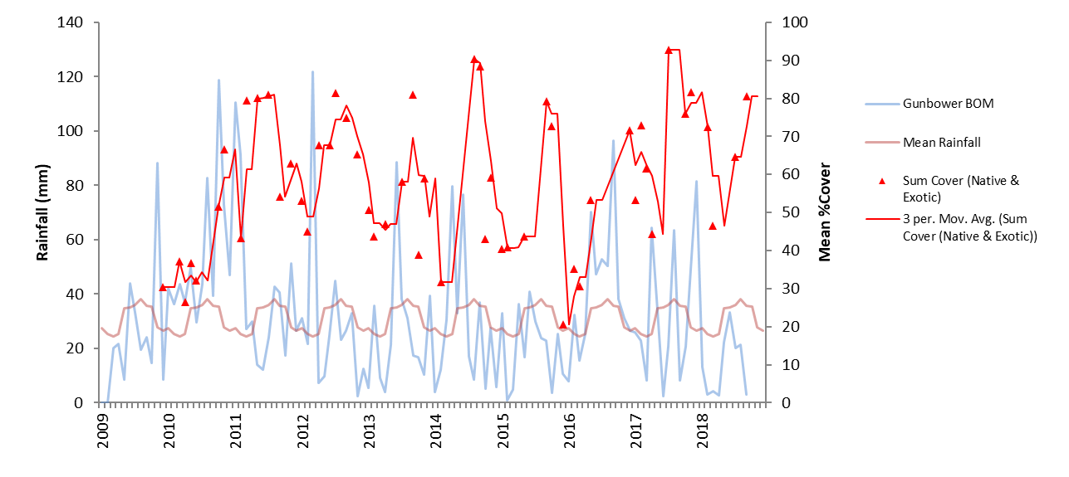
Sum Cover (Native & Exotic) = Erratic seasonal dynamics driven mostly by exotic annuals.
Even with grazing, system unstable with high amplitude = low resilience
Requires biomass reduction in most seasons to maintain values

Slide 27
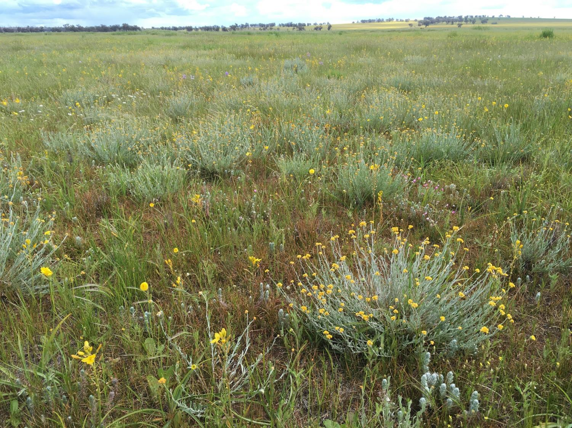
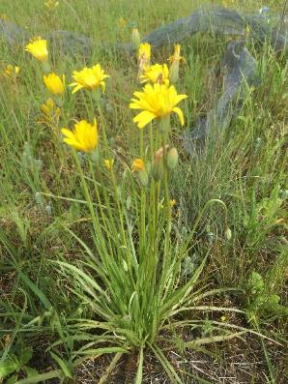
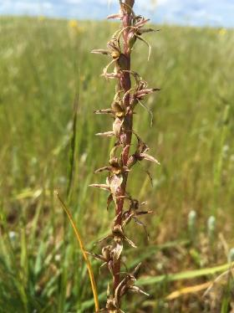
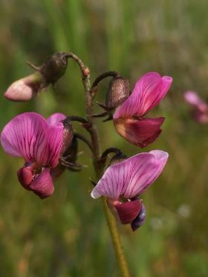
Conservation based grazing regimes (in terms of stocking rates and timing of rests etc.) can achieve similar results in sites were there is a long history of grazing and No cropping

Slide 28
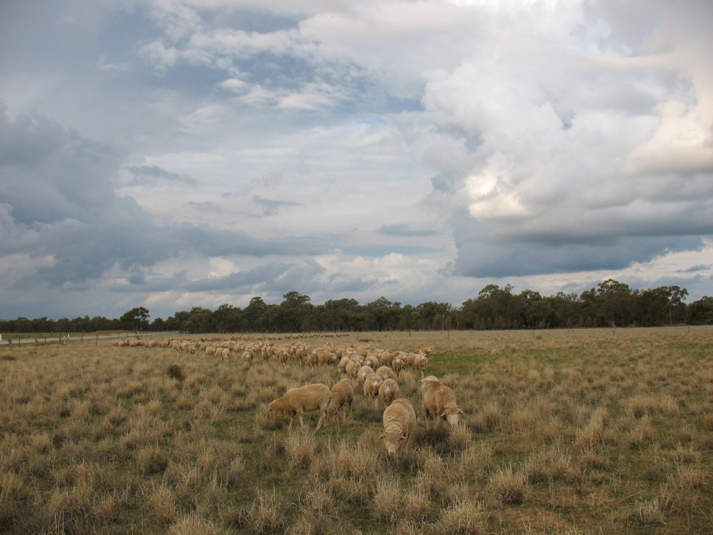

Slide 29
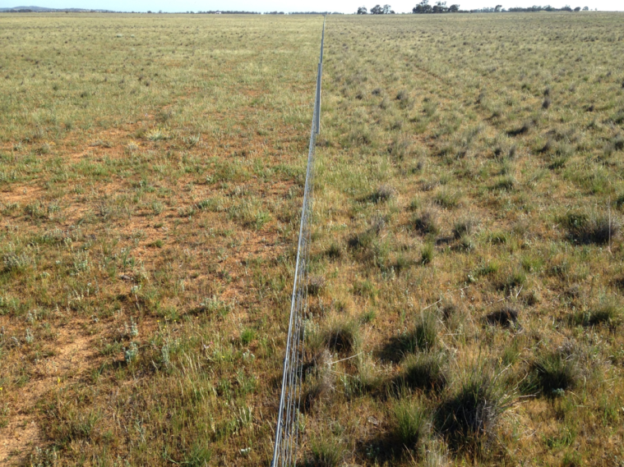
September 2015

Slide 30
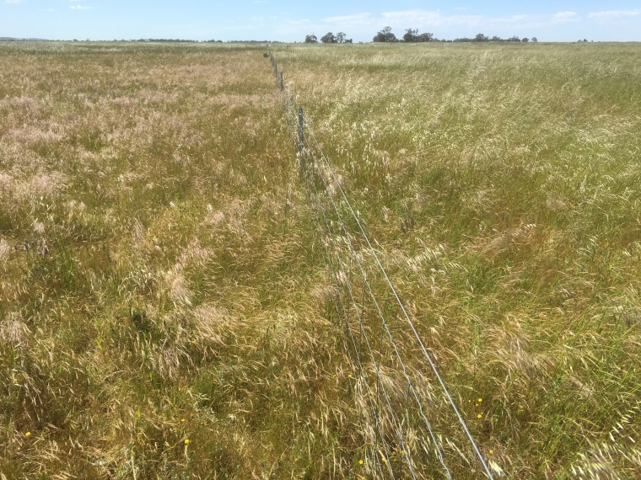
. October 2016.

Slide 31
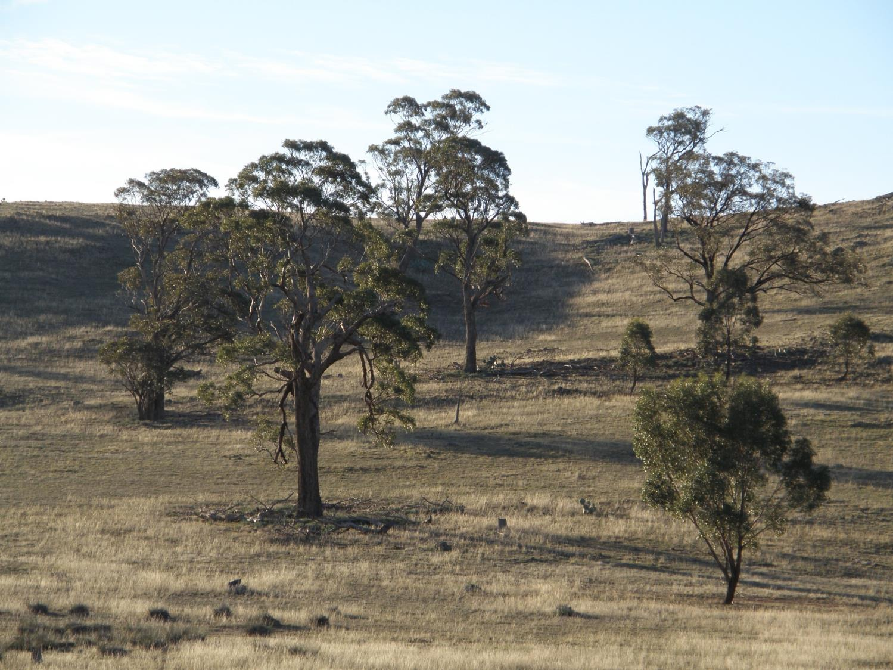

Slide 32
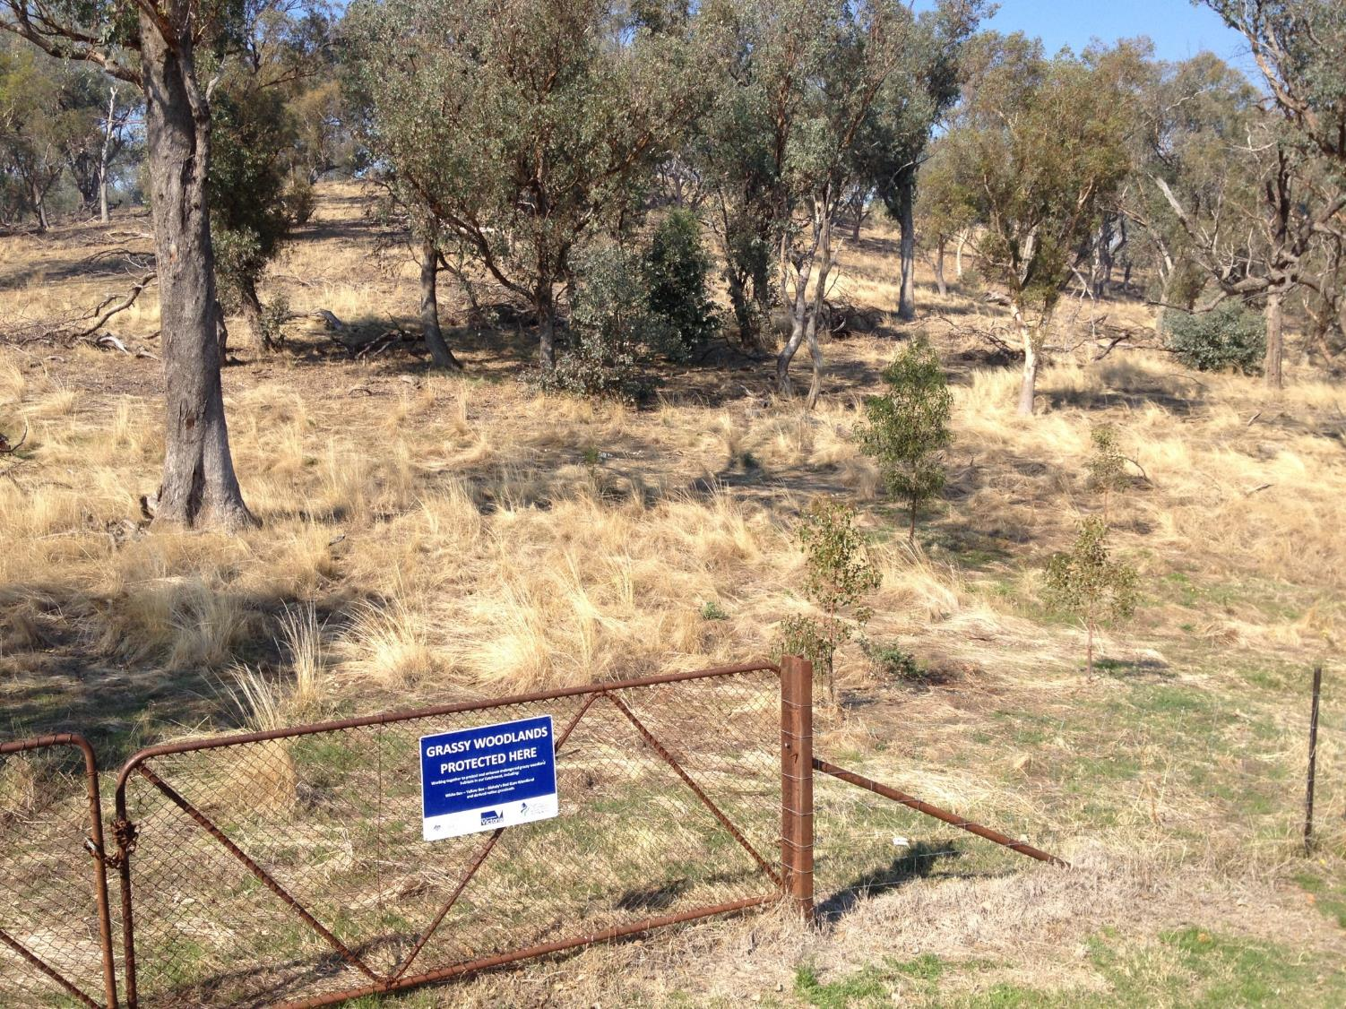

Slide 33
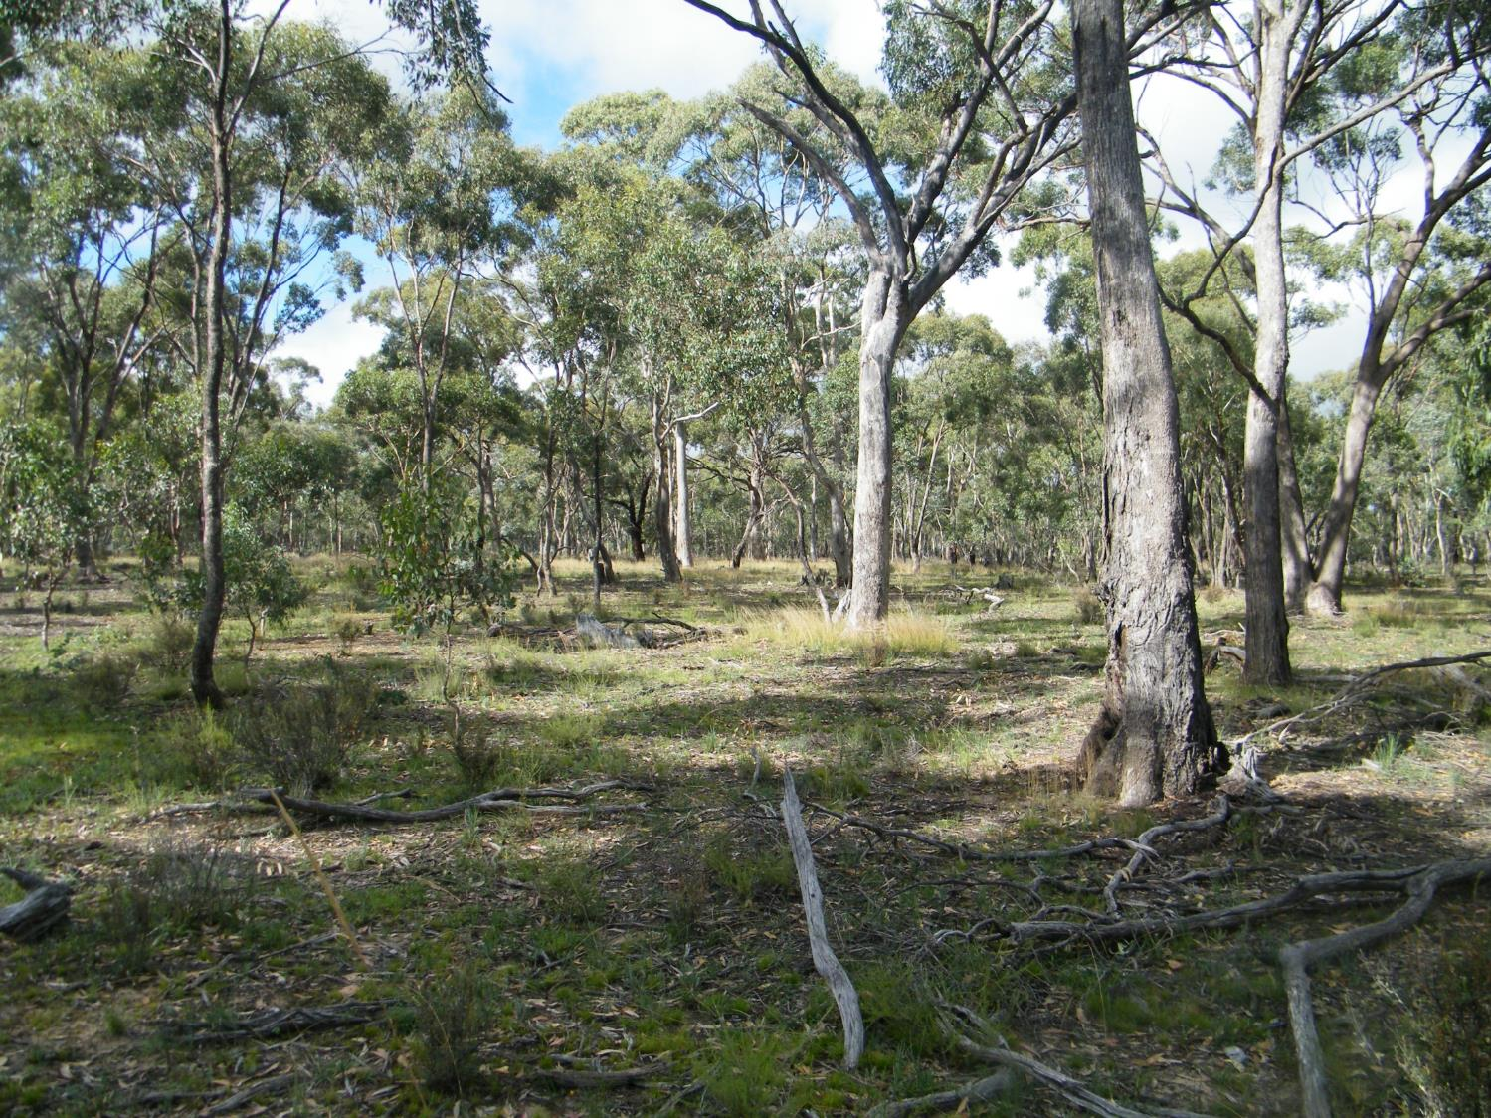
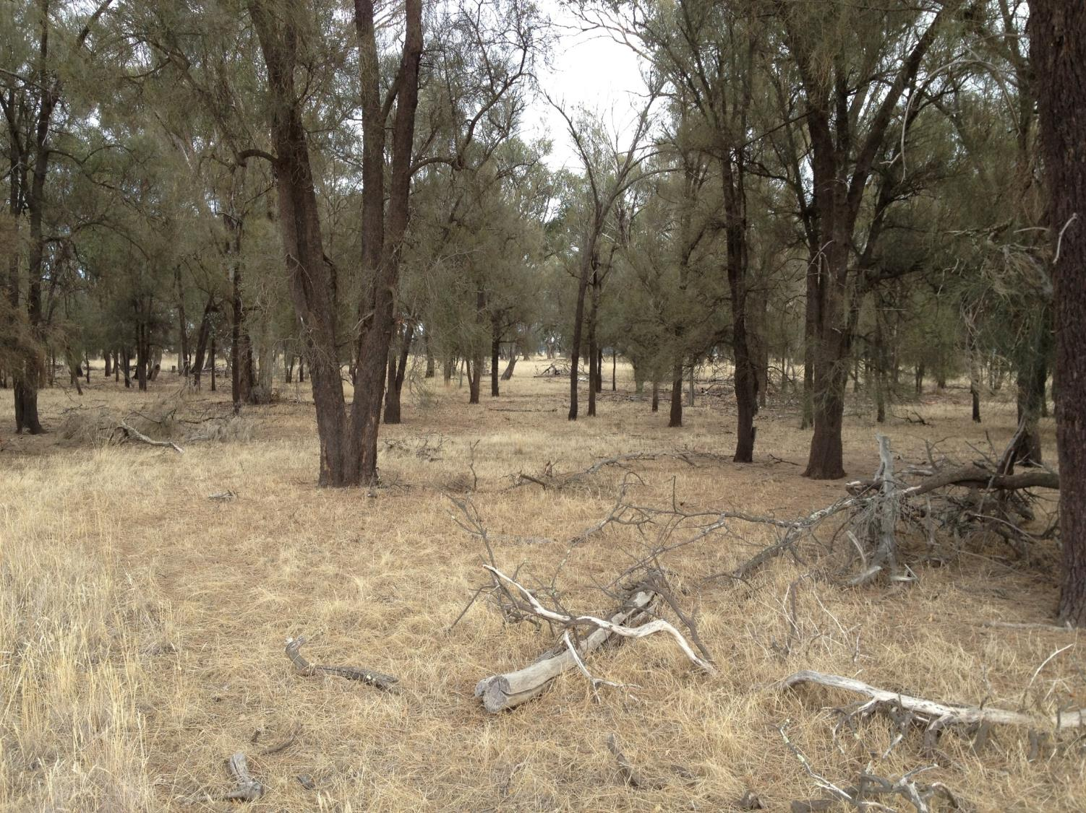

Slide 34
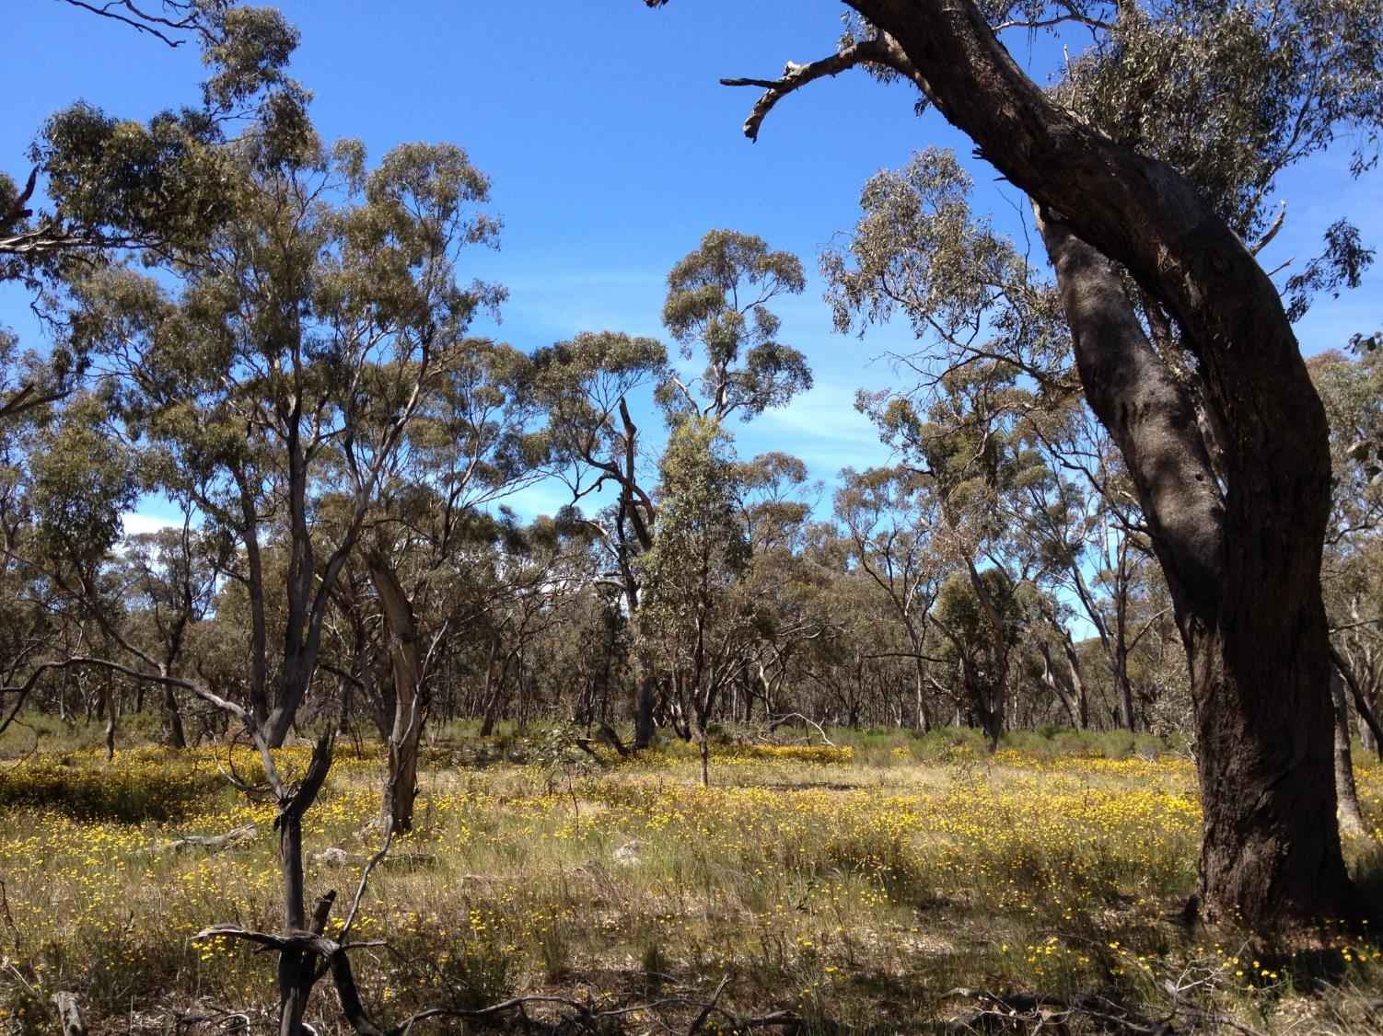

Slide 35
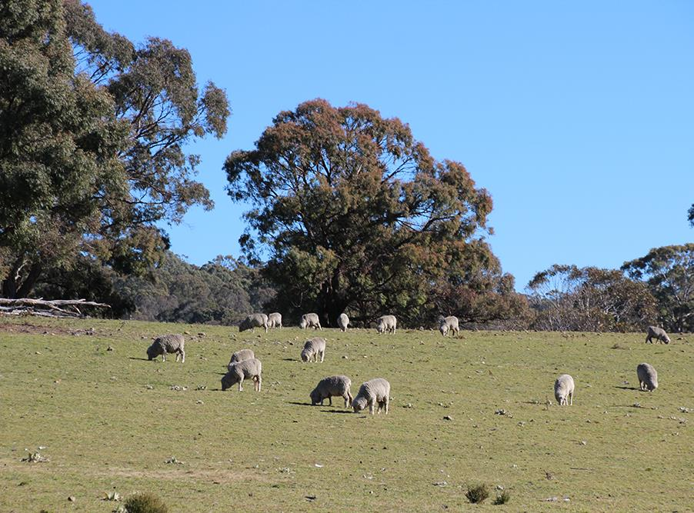
However, while conservation grazing (if managed well) can maintain values in some situations, there are risks and it is unclear if such management can play a role in long term restoration

Slide 36
Can fire play a role in restoration of grassy ecosystems?

Slide 37
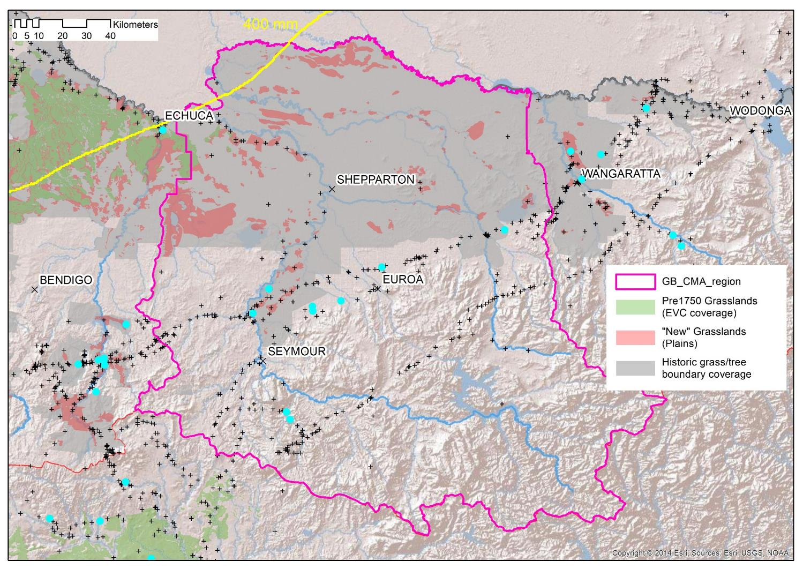

Slide 38
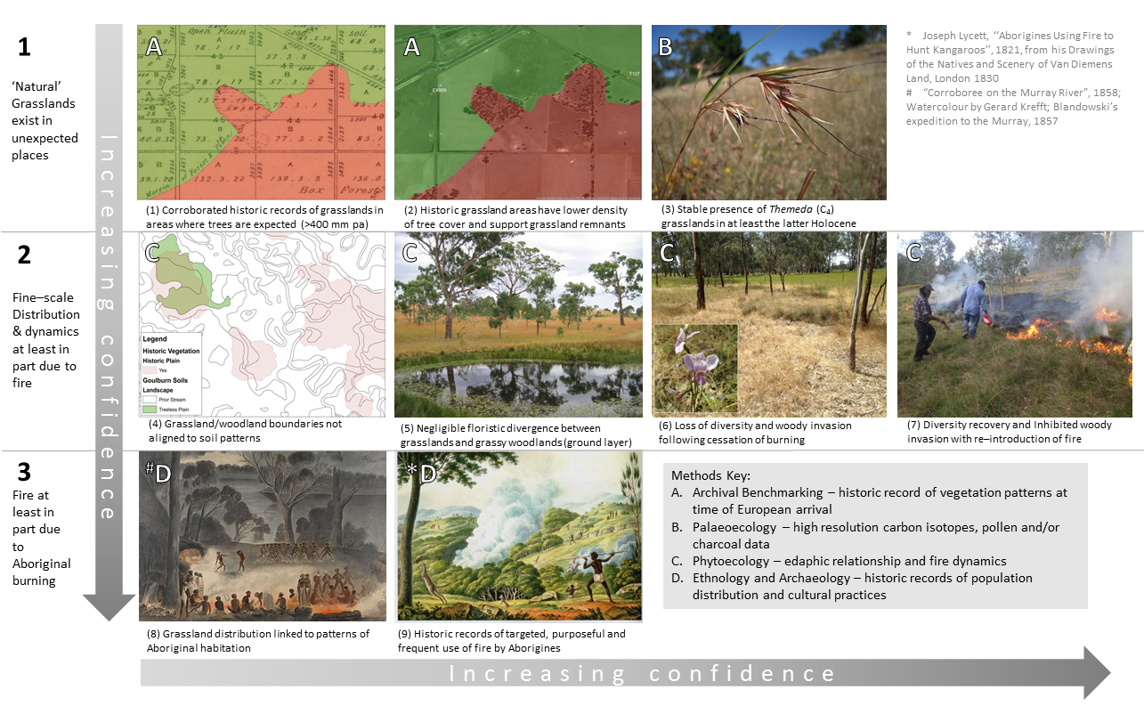

Slide 39
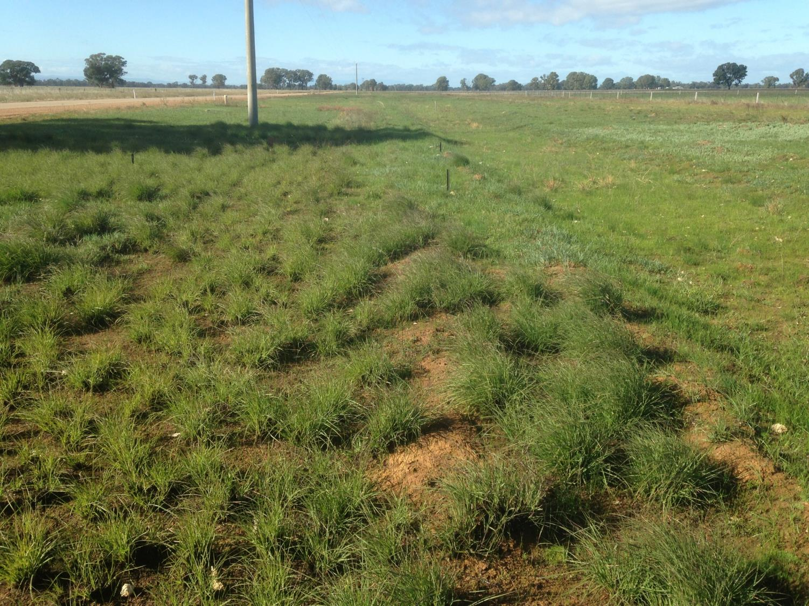
The ecological benefits of burning are particularly well known
The role of disturbance to frequently reduce biomass has long been recoginsed in grasslands – especially in mesic regions where Themeda is dominant

Slide 40
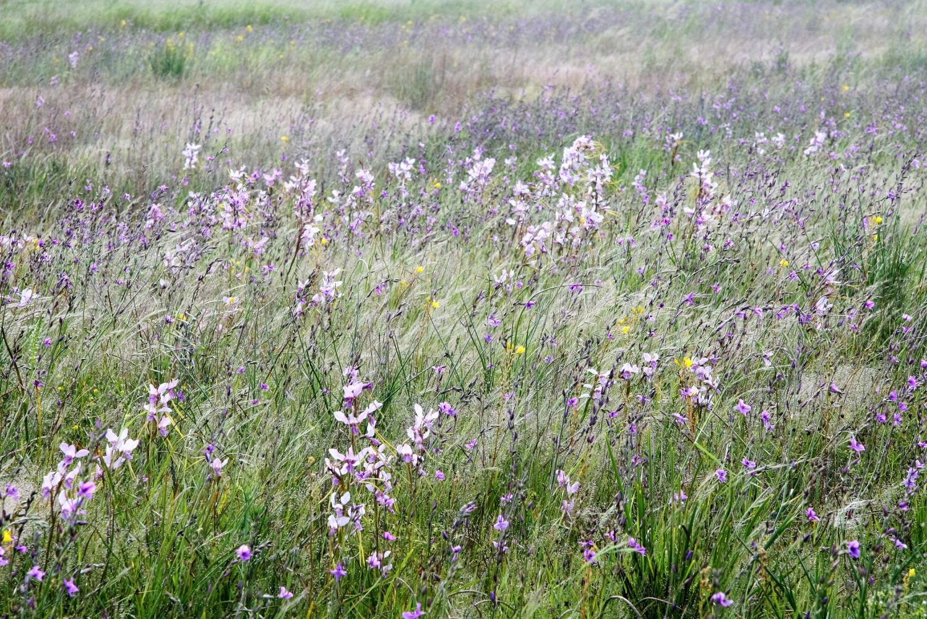
Fire stimulates mass growth, flowering and seed production which can lead to seedling regeneration in the following Autumn (if rainfall sufficient)

Slide 41
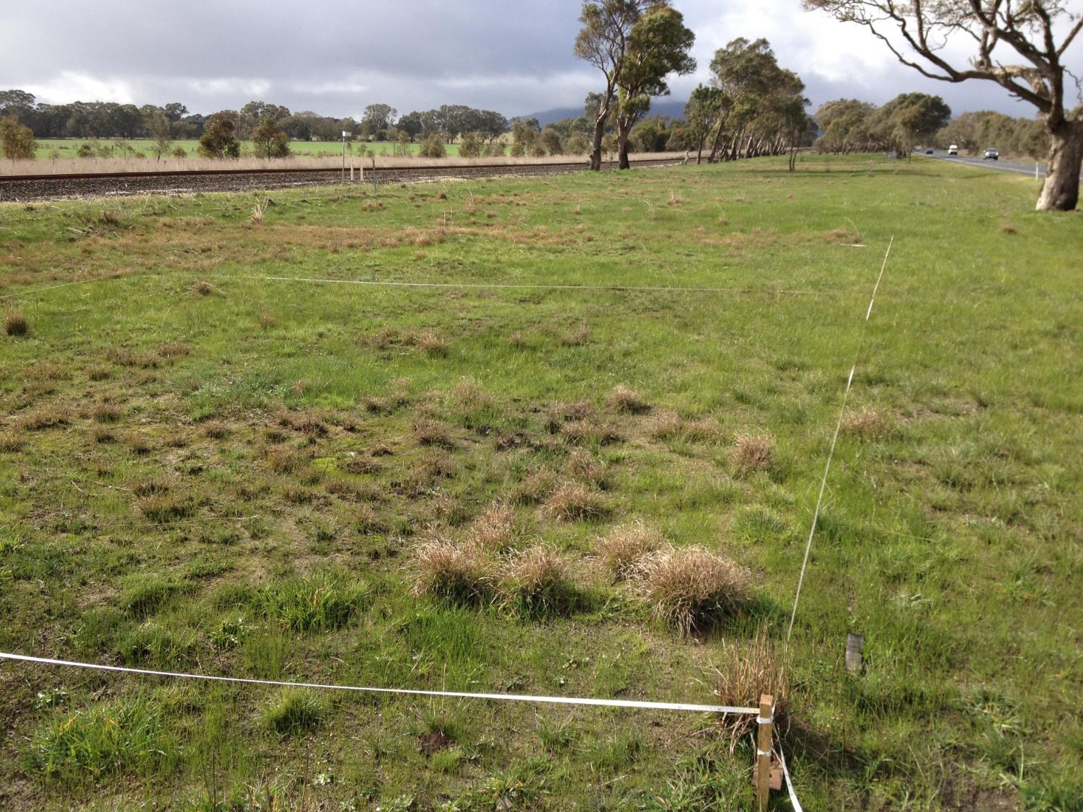
Regular removal of biomass of dominant lifeforms (grasses) improves light penetration and creates space for a diversity of less competitive inter-tussock species, esp. wildflowers

Slide 42
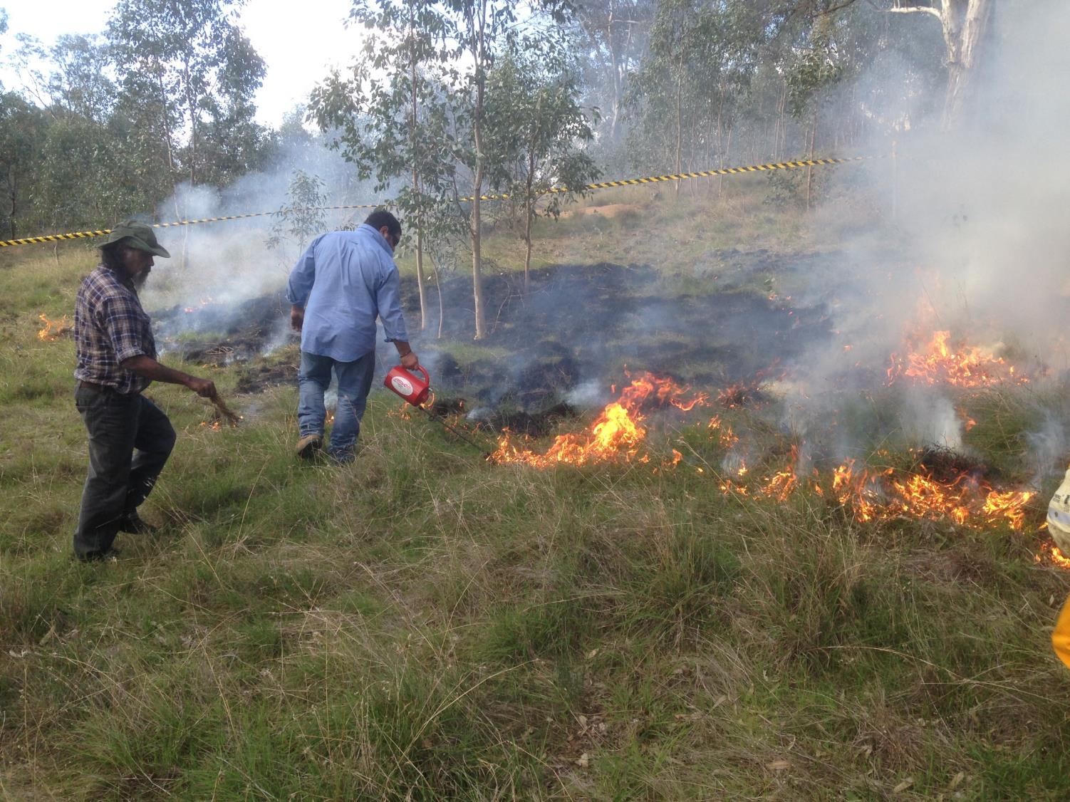
Ecological burning based on TEK in North East Victoria – Trial collaborations with TOs, CFA, CMA and Landcare
Looking at the potential to help “heal” (restore) grassy remnants

Slide 43
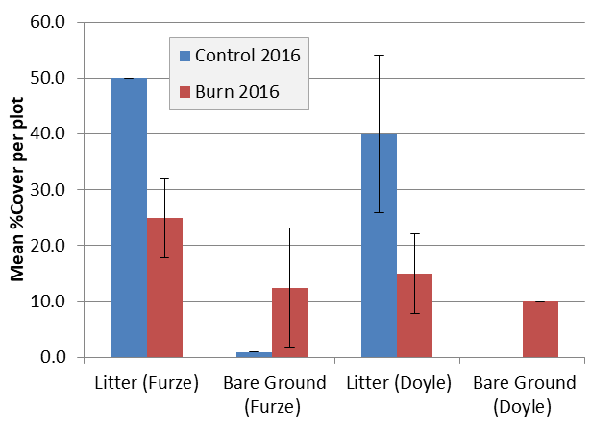
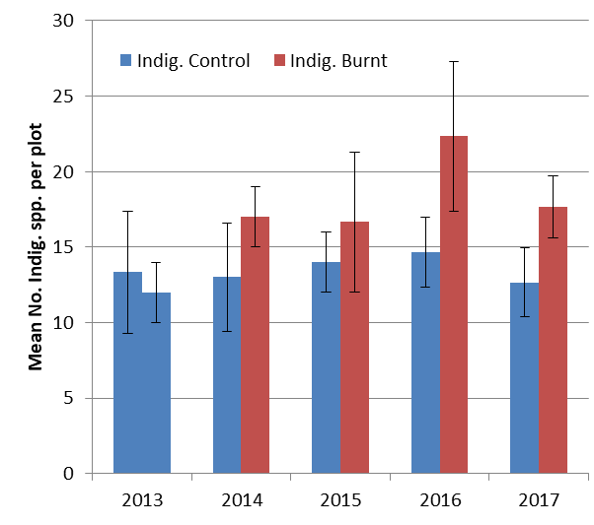
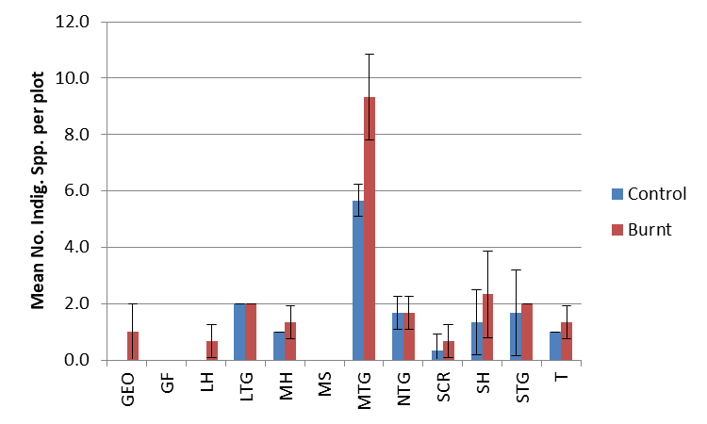
Clear impact of (Autumn) burning decreasing litter and increasing bare ground by following summer
Indigenous species density has increased under burning by 2016 but further increases limited by dispersal constraints and landscape homogeneity
Overall boost in native richness under burning mostly due to a range of widespread Medium Tussock Grasses

Slide 44
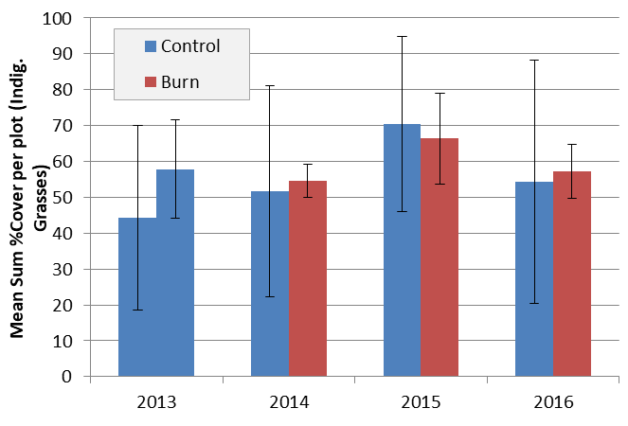
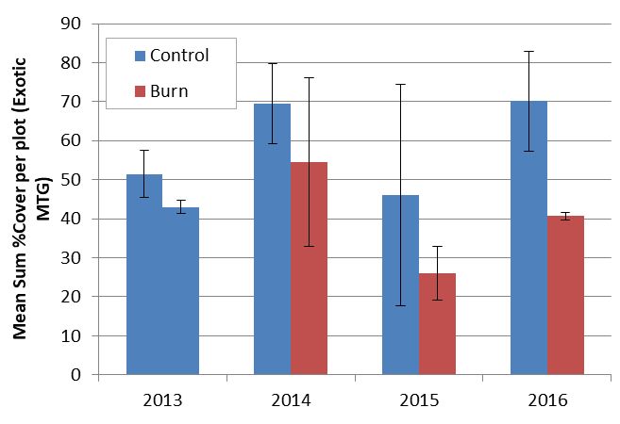
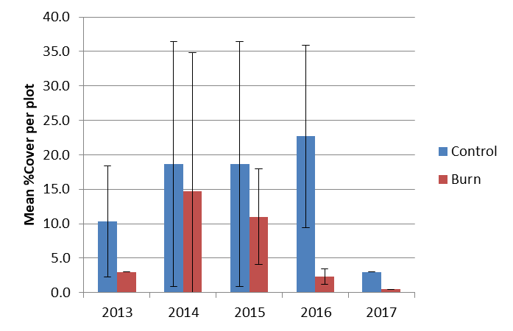
Indig. Tussock Grass %Cover showing no impact of (Autumn) burning on the abundance of native grasses by following summer
Exotic MTG %Cover showing the significant impact of burning reducing the abundance of annual exotic grasses
Abundance of Large Quaking Grass showing dramatic seasonal trends and reduction due to burning (low numbers in 2017 possibly due to dry conditions and/or lateness of assessment)

Slide 45



Bare Ground (%C) increased by burning (esp. if in successive years) via removal of litter and above ground biomass
Exotic annual grass (%C & richness) decreased by burning, although effect not present during drought (1994)
Burning did not significantly change the richness of the native flora throughout experiment.
Although continuous burning did result in the lowest richness levels (lots of annual plants?)

Slide 46


Slide 47


Slide 48







✓
?
?
✓
✓
?
✓
?

Slide 50



Further improvements with the reintroduction of forbs and other wildflowers to maintain sparse native grasses (inc. stability)
S2
S3
Frequent burning could expedite transition by reducing exotic annuals and boosting remaining native perennials
S4

Slide 51

Native Sum Cover (ADJ) = hypothetical elimination of exotic species (mostly annuals) using fire and increase in native forbs by 50% (perennial and annual) which combined reduces cover of native grasses by 50%;
Under this restoration scenario – once new, less unstable and more resilient state achieved, biomass reduction would need to be less intense and less often;
Note: Only really possible on non-friable, reddish clay loam soils

Slide 52
Conclusions
Mesic grassy ecosystems once widespread;
Grassland distribution linked to freq. human fire;
Now all but gone and rare remnants highly modified and CR;
Land use change = massive > grasses and loss of other species;
Unstable system requires intensive management and increased risk of extinctions;
Potential role for fire to reduce grass dominance & quickly transition into a better state when combined with forb reintroductions.

